Slide 1
ACCIDENT PREVENTION SYSTEM USING ARDUINO

Slide 2
OBJECTIVES
The primary objectives of this project are:
To design a reliable alcohol detection system that can accurately detect high levels of alcohol in the driver’s breath.
To implement an engine locking mechanism that disables the vehicle’s operation when alcohol is detected.

Slide 3

WORKING PRINCIPLE
Alcohol Detection: The MQ-3 sensor measures the concentration of alcohol in the air. When the driver exhales near the sensor, it detects the alcohol level.
Threshold Comparison: If the alcohol level is above a predefined threshold, the Arduino triggers the relay module, which cuts off the vehicle's ignition system or engine.
Alert Mechanism: Simultaneously, buzzer will start ringing the GSM module sends an SMS alert to a predefined number informing them about the alcohol detection.

Slide 4
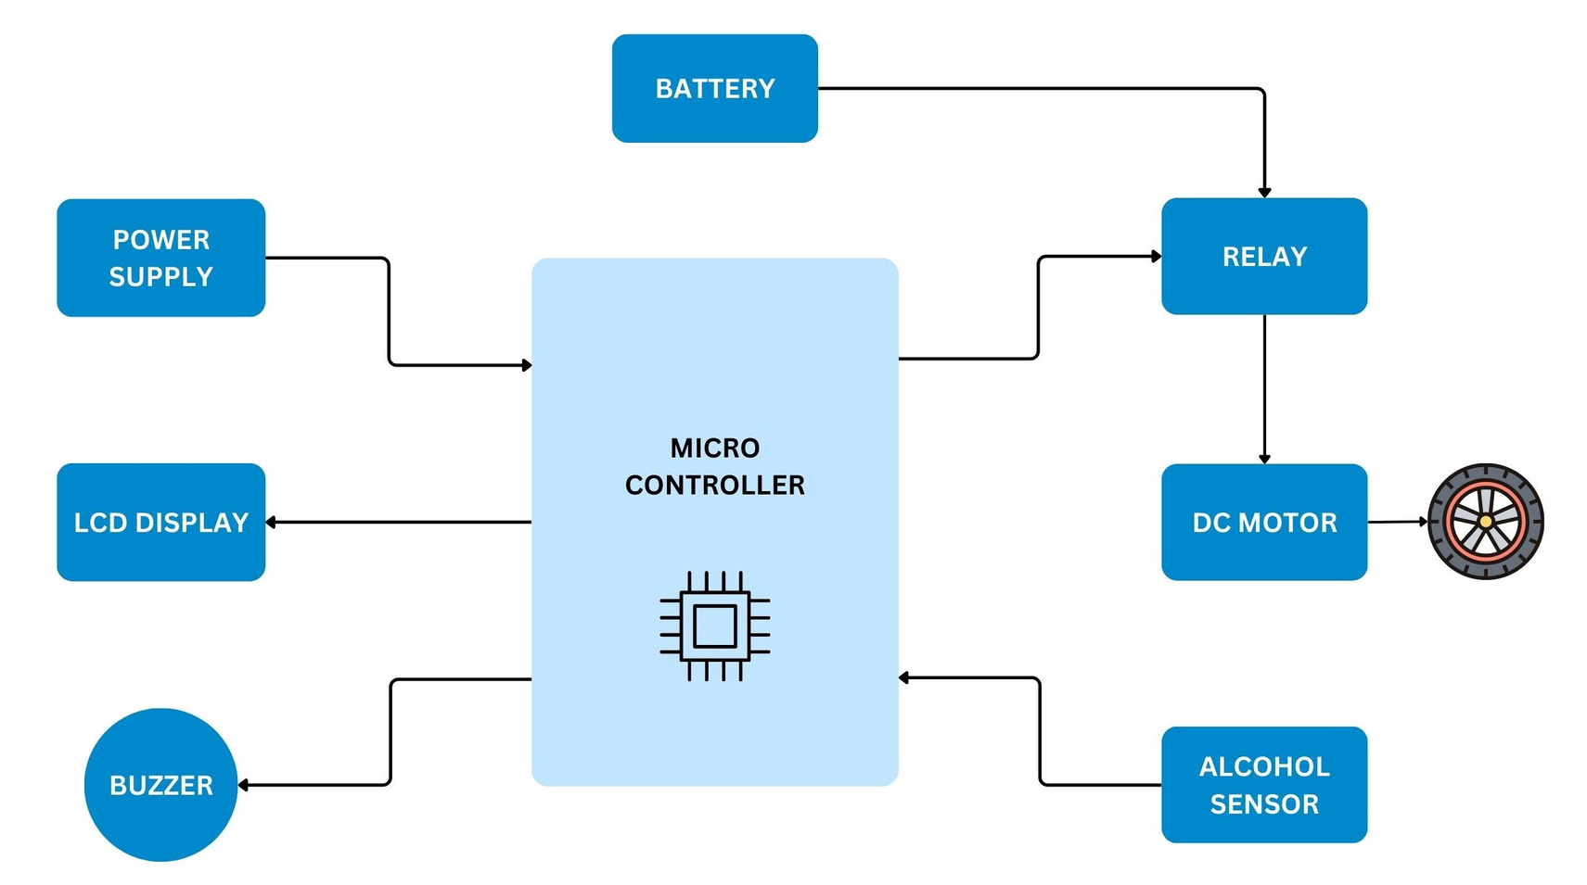
BLOCK DIAGRAM

Slide 5
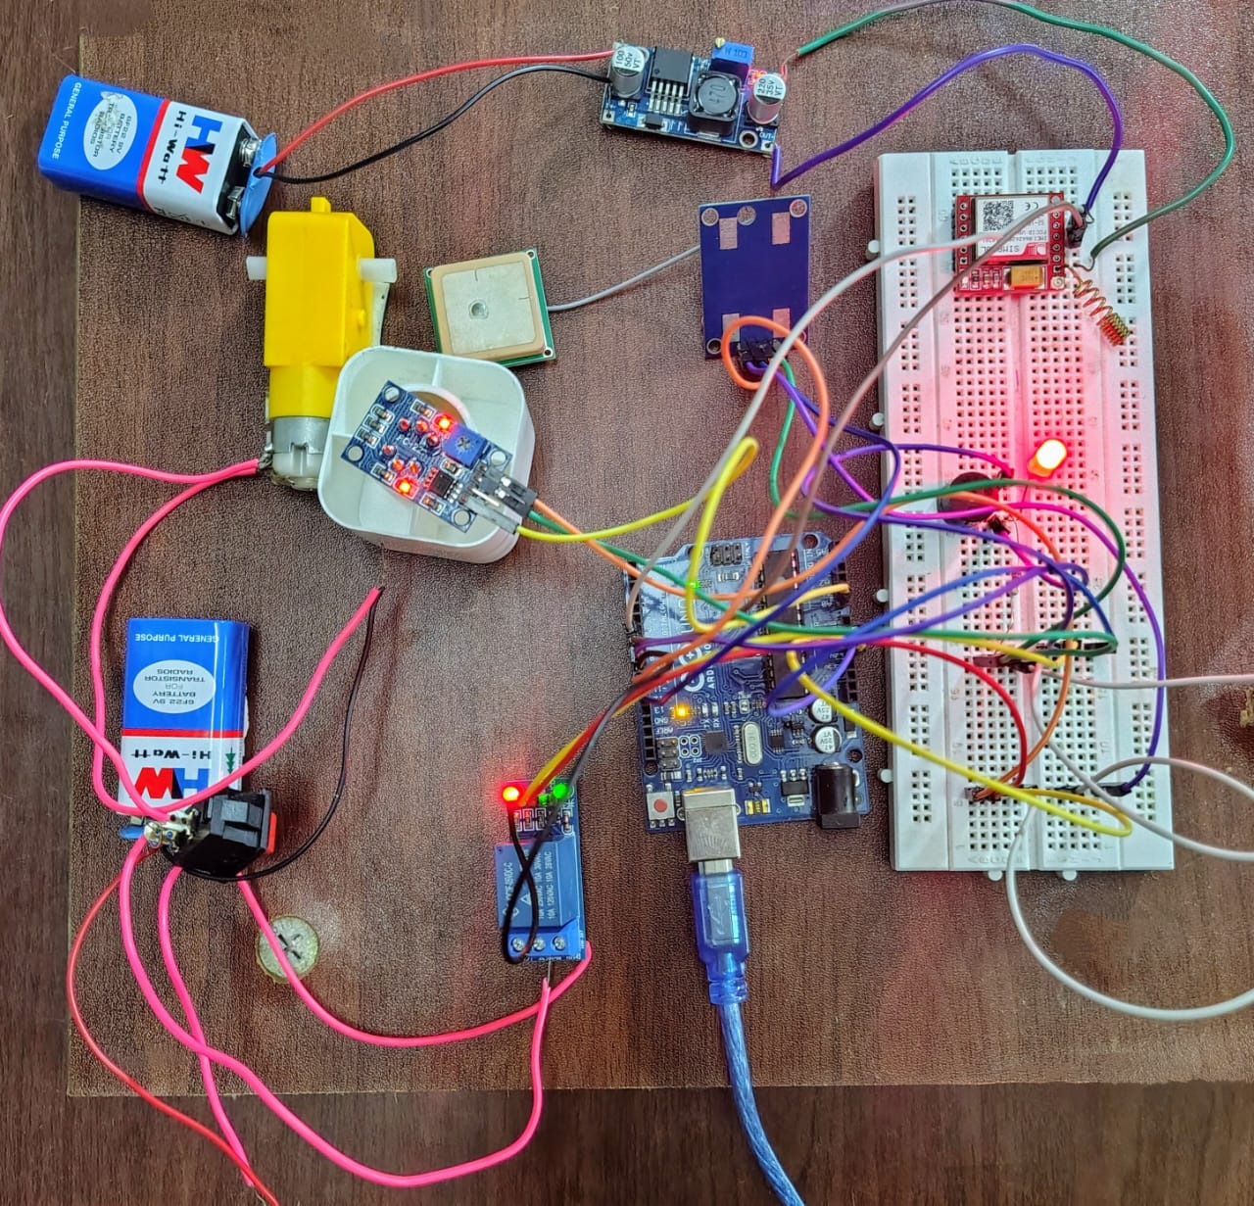
CIRCUIT DIAGRAM
Components
Arduino Uno
Relay module
Switch
Motor
MQ3 Sensor
9V battery
Neo 6M GPS module
GSM SIM 800L Module
Buzzer
Led
Breadboard
LM 2596 step down Converter

Slide 6
POTENTIAL ENHANCEMENTS
GPS Module: Add GPS to send the vehicle's location along with the alert.
Mobile App Integration: Create a mobile app to receive notifications and control the system remotely.
Data Logging: Store data related to alcohol detection events for future analysis.

